Slide 1
Bresenham Algorithm for Rasterization
Done By:
B. Akshayraj (RA2211028010079)
N. Inigo Jeevan (RA2211028010114)
A.S. Jai Kishore (RA2211028010117)

Slide 2
CONTENTS
INTRODUCTION
PROBLEM STATEMENT
ALGORITHM
TIME COMPLEXITY
APPLICATIONS
CONCLUSION

Slide 3
INTRODUCTION
Rasterization is the process of converting vector graphics or descriptions of shapes into a raster or pixel-based format for display or printing. In rasterization, geometric shapes are rendered onto a grid of pixels, where each pixel's color is determined based on its position relative to the shapes being rendered.
Rasterization plays a vital role in various applications, particularly in the realm of computer graphics and visualization.
Line Drawing algorithms like DDA, Bresenham and Wu’s algorithms are used along with scanline and interpolation algorithms to render a coloured 2d polygon.

Slide 4
PROBLEM STATEMENT
The problem statement for the Bresenham algorithm involves efficiently determining which pixels to activate in order to draw a straight line between two given points on a grid:
Pixel Selection:
Given two endpoints in the raster (pixels), the algorithm must determine which pixels to activate to approximate the straight line connecting these points. The challenge lies in selecting the optimal set of pixels that minimizes visual artifacts such as jagged edges while maintaining computational efficiency.

Slide 5
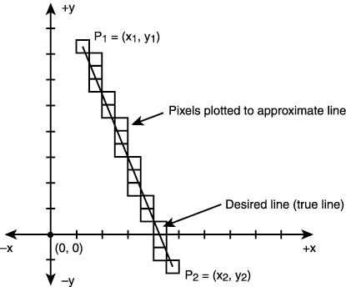
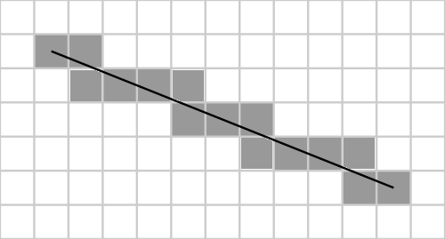
Integer Arithmetic:
Another aspect of the problem is performing calculations using only integer arithmetic to avoid the computational overhead of floating-point operations. This constraint is essential for real-time rendering applications where performance is critical. The algorithm needs to accurately determine the slope of the line and incrementally select the appropriate pixels without resorting to costly floating-point calculations, ensuring both precision and efficiency in rasterization processes.
DDA (Digital Differential Analyzer) algorithm uses floating point arithmetic which leads to speed redundancy.

Slide 6
ALGORITHM
The Bresenham Line Drawing Algorithm is utilized in rasterization to efficiently draw lines on a grid of pixels.
Incremental calculation: BLDA calculates pixel positions incrementally along the x-axis while determining the corresponding y-coordinates based on the slope of the line. It avoids using floating-point numbers for slope calculation.
Error term: BLDA uses an error term to make decisions about which pixel to plot next. This error term is updated at each step of the algorithm, and the decision-making process involves comparing integer values, rather than floating-point values.
By employing integer arithmetic exclusively, BLDA eliminates the need for costly floating-point operations, resulting in faster execution and better efficiency, especially in environments where computational resources are limited or speed is critical, such as real-time graphics rendering.

Slide 7
ALGORITHM
The Step-by-Step Algorithm for BDLA:
1. Input:
Starting point coordinates: (x1, y1)
Ending point coordinates: (x2, y2)
2. Initialization:
Calculate the change in x (dx): dx = x2 - x1
Calculate the change in y (dy): dy = y2 - y1
Initialize an error term (p): d = 2 * dy - dx
Algorithm Bres(x,y,x2,y2)
{
x = x1; y=y1;
dx=x2-x1 ; dy=y2-y1;
p = 2dy-dx;
while(x<=x2)
{
putpixel(x,y);
x++;
if(p>0)
{p = p + 2*dy – 2*dx;
y++;
}
else
{p = p + 2*dy; }
}
}

Slide 8
ALGORITHM
3. Looping:
Iterate from x1 to x2
Plot the current pixel at (x, y)
Check the error term:
If d > 0:
Increment y by 1
Update error : p = d + 2 * (dy - dx)
If d <= 0:
Keep y the same
Update the error term: p = d + 2 * dy
Increment x by 1
4. Output:
This loop will iterate through all the pixels closest to
the actual line segment connecting the
starting and ending points.
Algorithm Bres(x,y,x2,y2)
{
x = x1; y=y1;
dx=x2-x1 ; dy=y2-y1;
p = 2dy-dx;
while(x<=x2)
{
putpixel(x,y);
x++;
if(p>0)
{p = p + 2*dy – 2*dx;
y++;
}
else
{p = p + 2*dy; }
}
}

Slide 9
TIME COMPLEXITY
Time Complexity Analysis:
The number of iterations directly relates to the absolute difference between x and y coordinates (max(|dx|, |dy|)).
In each iteration, the algorithm performs constant time operations (comparisons, additions, and subtractions).
Therefore, the time complexity of the Bresenham algorithm is:
T(n) = O(max(|dx|, |dy|))
This indicates that the algorithm's execution time grows linearly with the greater absolute difference between the starting and ending points' x and y coordinates.

Slide 10
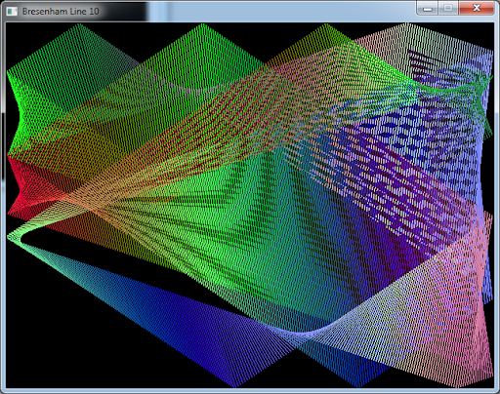
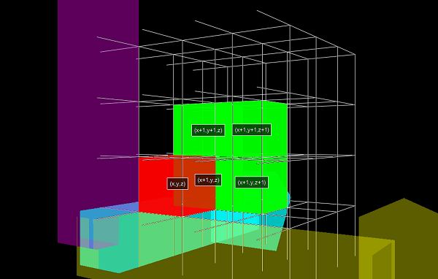
APPLICATIONS
Bresenham's Line Drawing Algorithm (LDA) is widely used in computer graphics for efficiently drawing lines on raster displays. Its applications range from basic line drawing in graphics editors and CAD software to advanced rendering in video games and simulations. Bresenham's LDA is also utilized in medical imaging for generating precise representations of structures like blood vessels and bones. Furthermore, it finds application in geographic information systems (GIS) for drawing maps and visualizing spatial data with straight-line segments efficiently.

Slide 11
CONCLUSION
In conclusion, the Bresenham algorithm is used in rasterization for:
Efficient Line Drawing: It determines which pixels to illuminate to form an accurate approximation of a straight line between two points on a raster display (like a computer screen).
Fast Rendering: By relying solely on integer arithmetic (addition, subtraction, bit shifting), the algorithm significantly reduces computation time compared to methods using floating-point operations.
Hardware Friendliness: These efficient computations make the Bresenham algorithm well-suited for implementation on various hardware architectures, enabling smooth and precise line rendering in graphics applications.
Therefore, the Bresenham algorithm plays a crucial role in rasterization by ensuring fast and accurate line rendering on digital displays.

